Slide 1
Linux Assembly
Armine Hayrapetyan

Slide 2
Outline
Flags
Pointers
Control Flow
Jumps
Comparisons
Calls

Slide 3
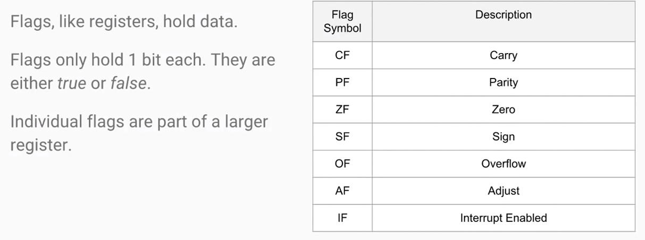
Flags

Slide 4
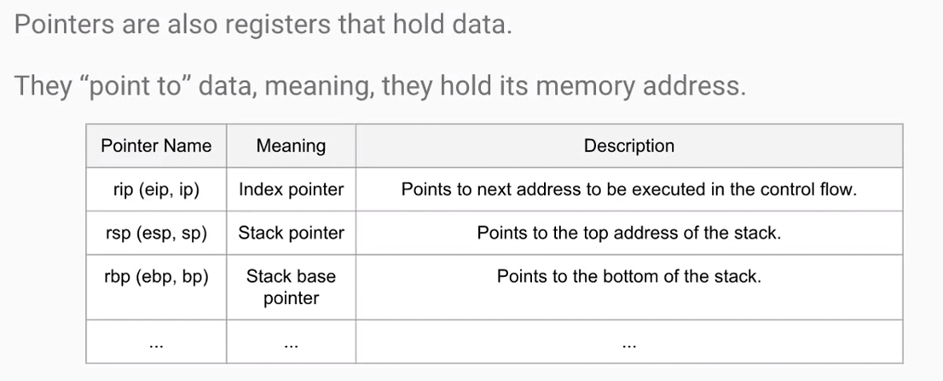
Pointers

Slide 5
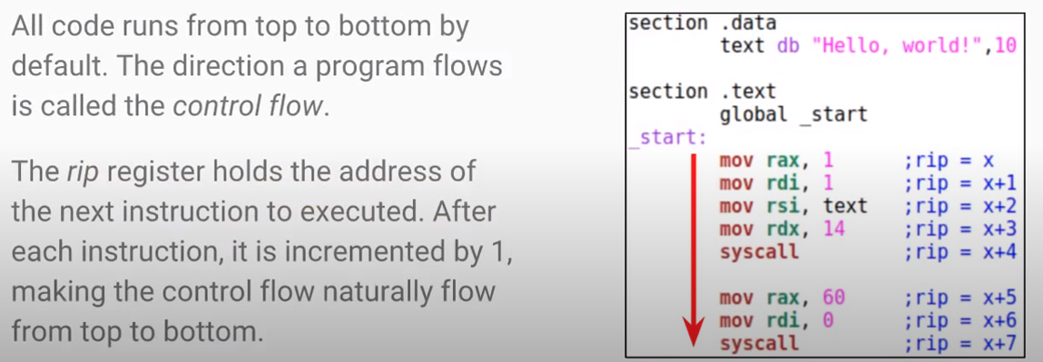
Control Flow

Slide 6
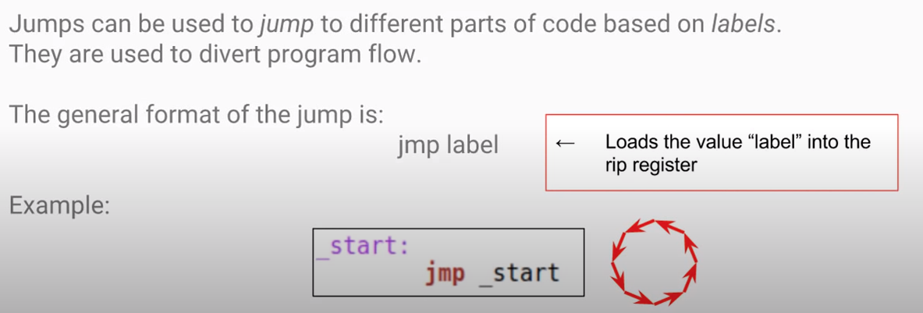
Jumps

Slide 7
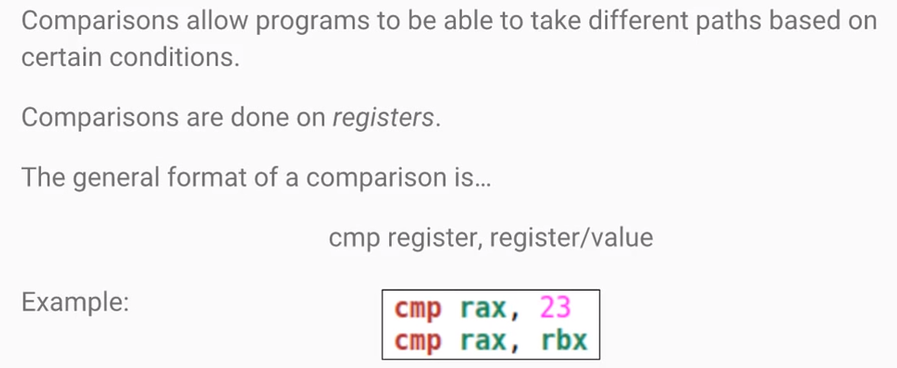
Comparisons

Slide 8
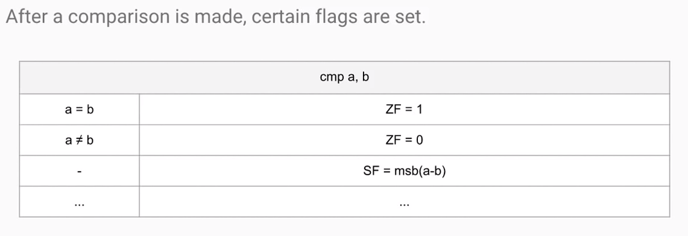
Comparisons with Flags

Slide 9
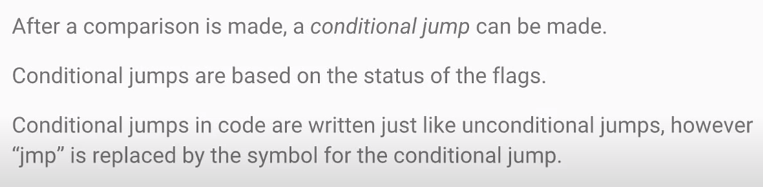
Conditional Jumps

Slide 10
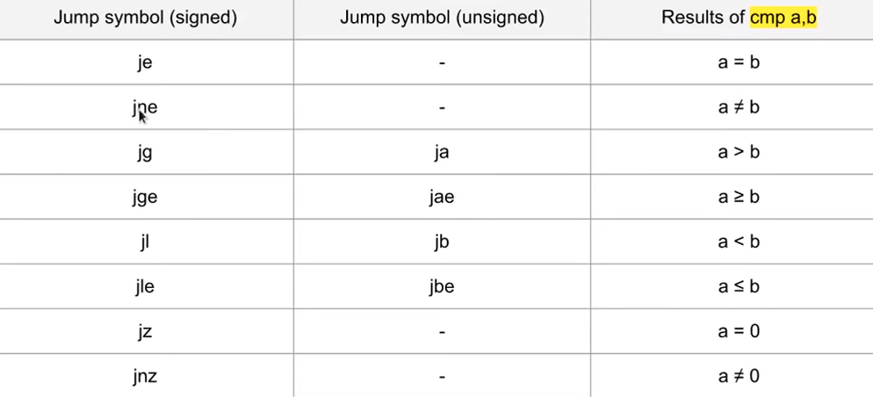

Slide 11
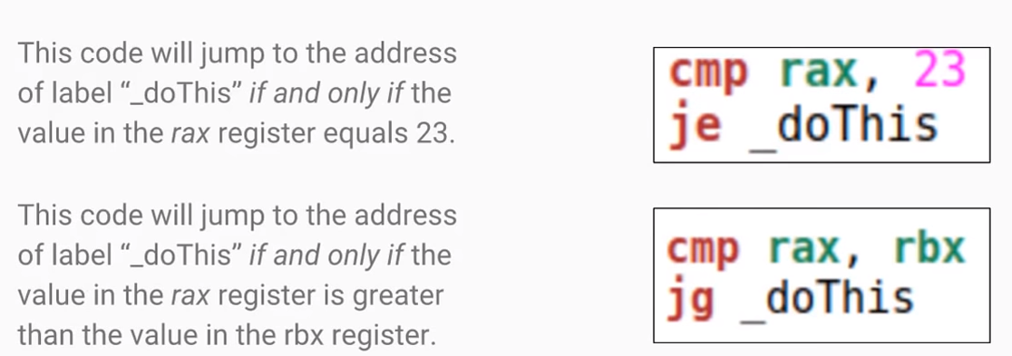
Conditional Jump Examples

Slide 12
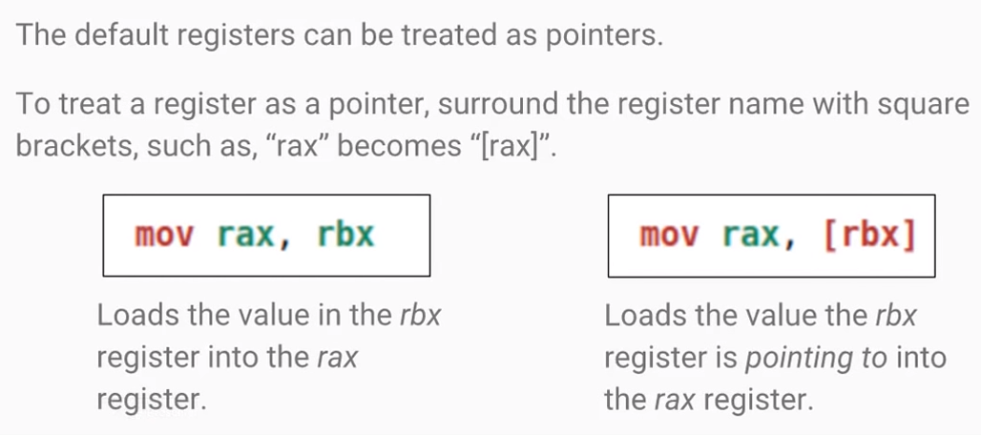
Registers as Pointers

Slide 13
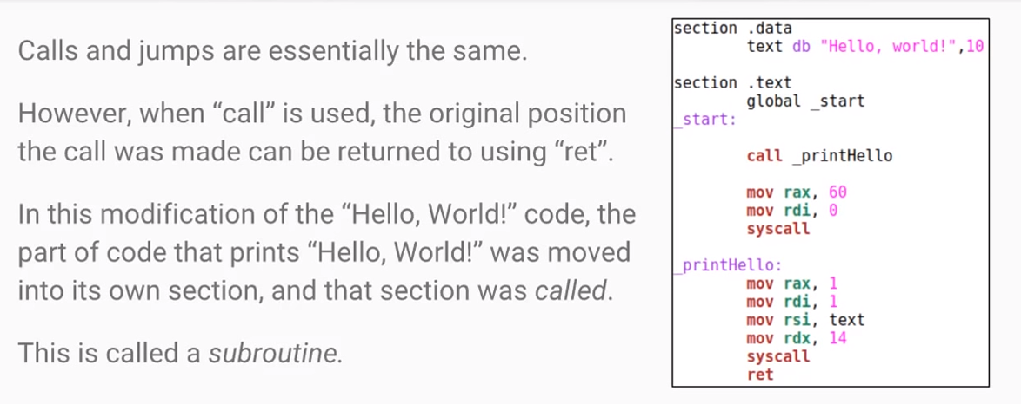
Calls

Slide 14
References
https://www.youtube.com/watch?v=busHtSyx2-w&list=PLetF-YjXm-sCH6FrTz4AQhfH6INDQvQSn&index=3

